Slide 1


Slide 2

TRACKING SYSTEM FOR MISSING PERSONS
TEAM MEMBERS :
2110030351 - H. Manasa
2110030352 - T. Nikitha Reddy
2110030449 - A. Sri Varshini
2110039476 – Sai Nived
Under the guidance of :
Dr.Shadab

Slide 3

Agenda
Introduction
Naïve Solutions
Merits & Demerits
Design Modelling Diagram
Articles
Required Data Base & Tools
Working process
GitHub Setup
Individual Roles

Slide 4
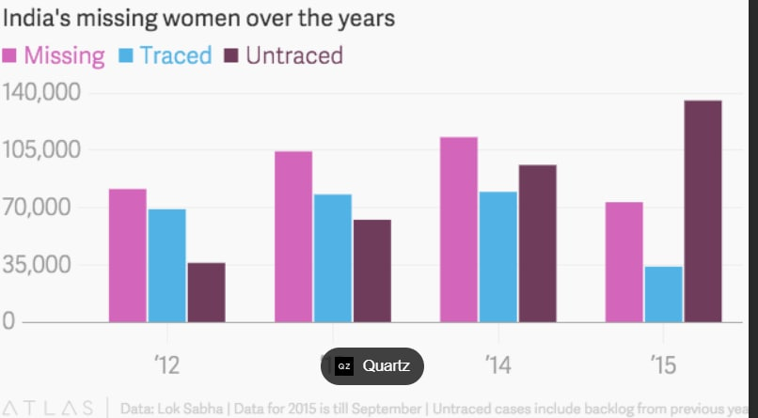
Introduction
Manual System for finding missing person have very long procedure and takes more time. More time is require for launching an FIR in police station to find lost person. Also during manual process number of manpower for searching lost person is less.
To overcome from this , we wanted to develop an application which makes the task easier to find the missing person.

Slide 5

Naïve Solutions
There are many lost and found systems which are more concerned with things like mobile phones, watches, wallets, etc.
The names of such systems are vFound, etc.
The US National Institute of Justice’s National Missing and Unidentified Persons System (NamUs) is a national centralized repository and resource center for missing persons.

Slide 6
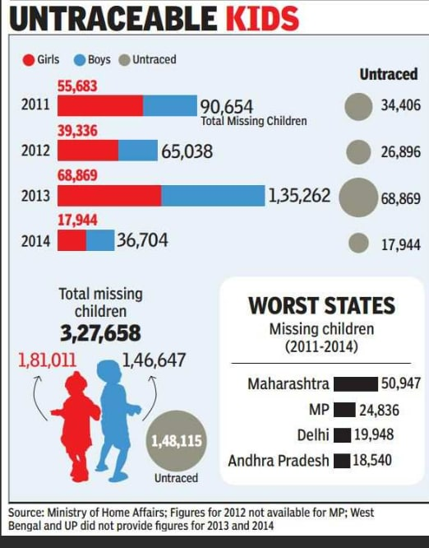
Merits & Demerits
Merits of our appilication :
• Easy to upload and view Complaint.
• All trust users can add complaint.
• Simple GUI.
• Easy to view information
Demerits of our appilication :
• Require Internet connection.
• Require android phone with camera.

Slide 7
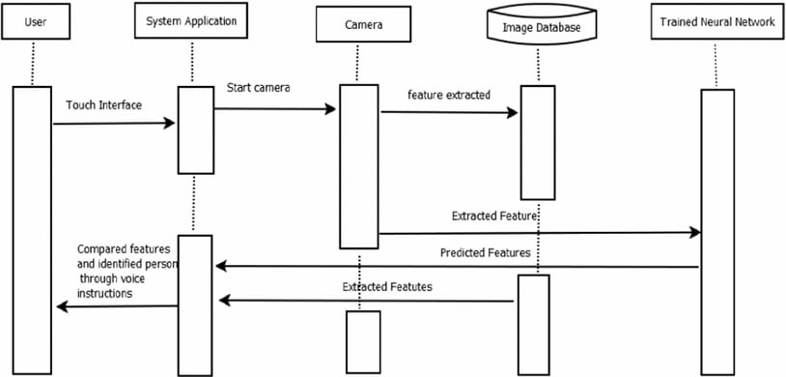
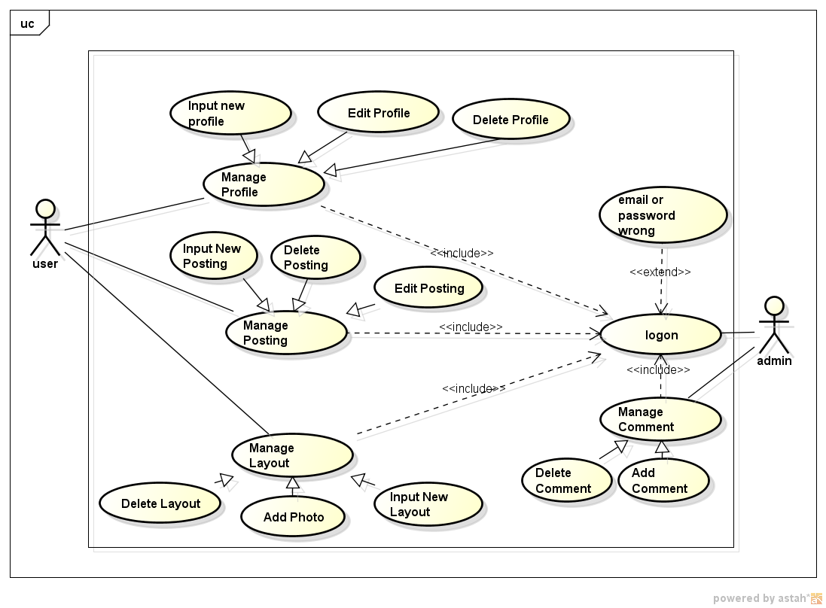
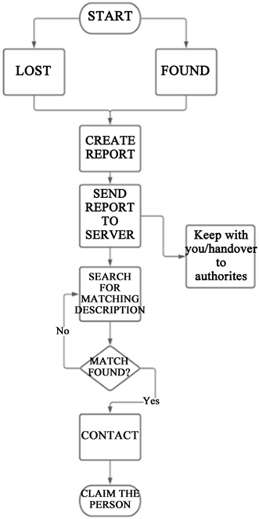
Design Modelling Diagrams
SEQUENCE
USE - CASE
FLOW

Slide 8

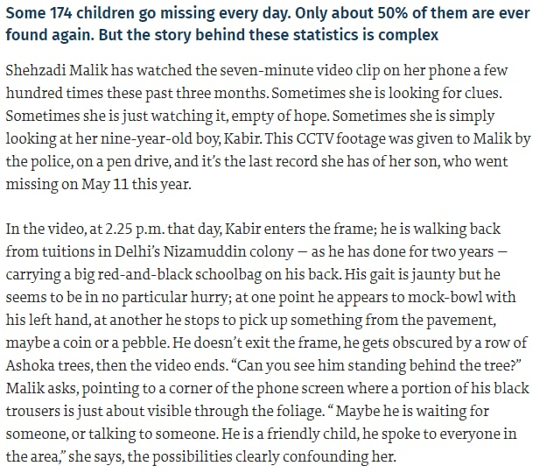
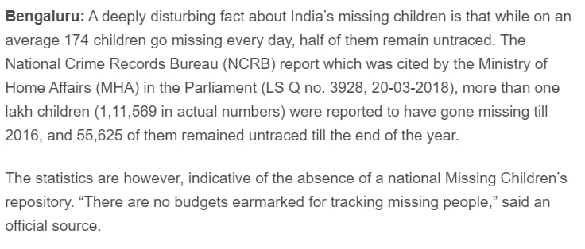
Articles

Slide 9

Required Data Base & Tools
Database is responsible for storing all information in well-defined format. Also it responses to the queries fired by client to add, update, remove or search records. In Our project we have used
Pycharm
SDK
PythonTwinker
StarUML
XAMPP Server with APACHE and MYSQL database to store information.
SOFT WARE
A. Hardware Requirement:
Processor: Intel 1.66GHz Processor Pentium 4
RAM: 256MB Hard disk: 80GB
Device: GPRS enabled Mobile Phone with Android
OS
HARD WARE

Slide 10
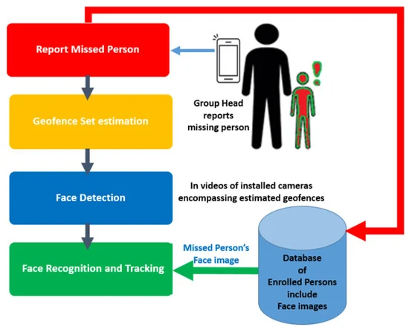
Working process

Slide 11

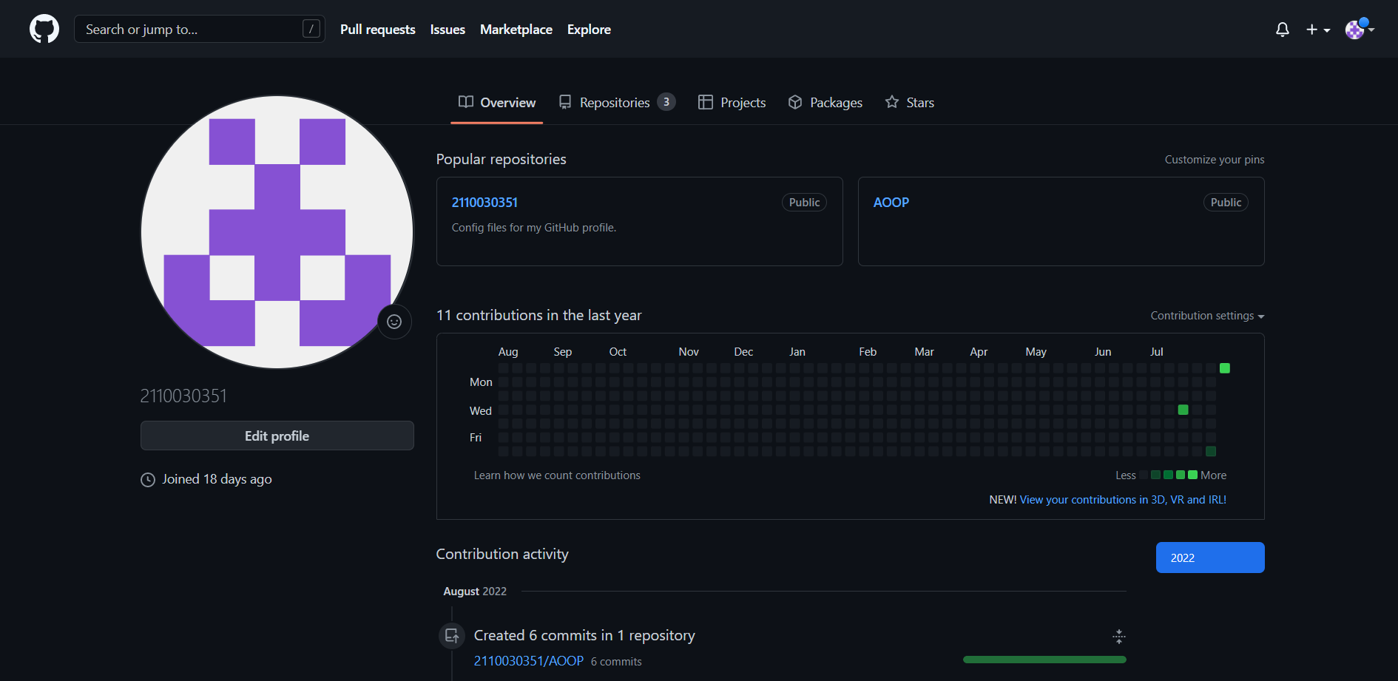
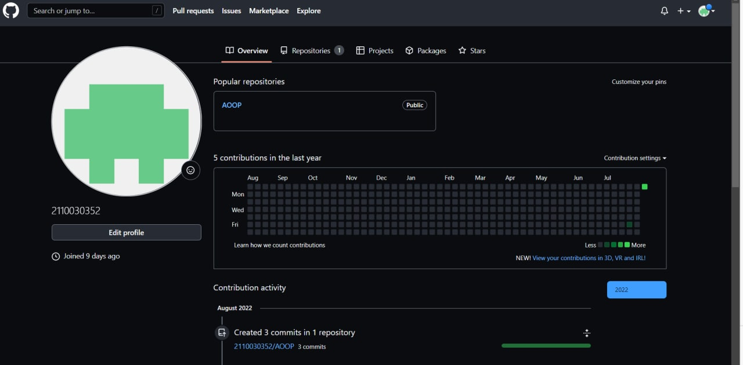
Github setup
2110030351 (github.com)
https://github.com/2110030352

Slide 12
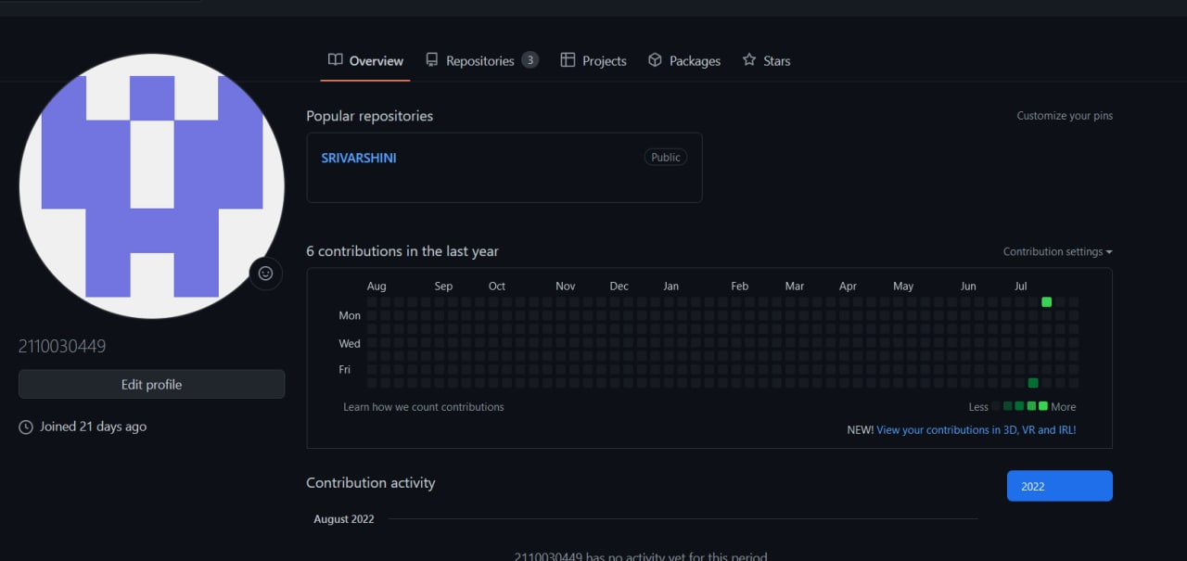
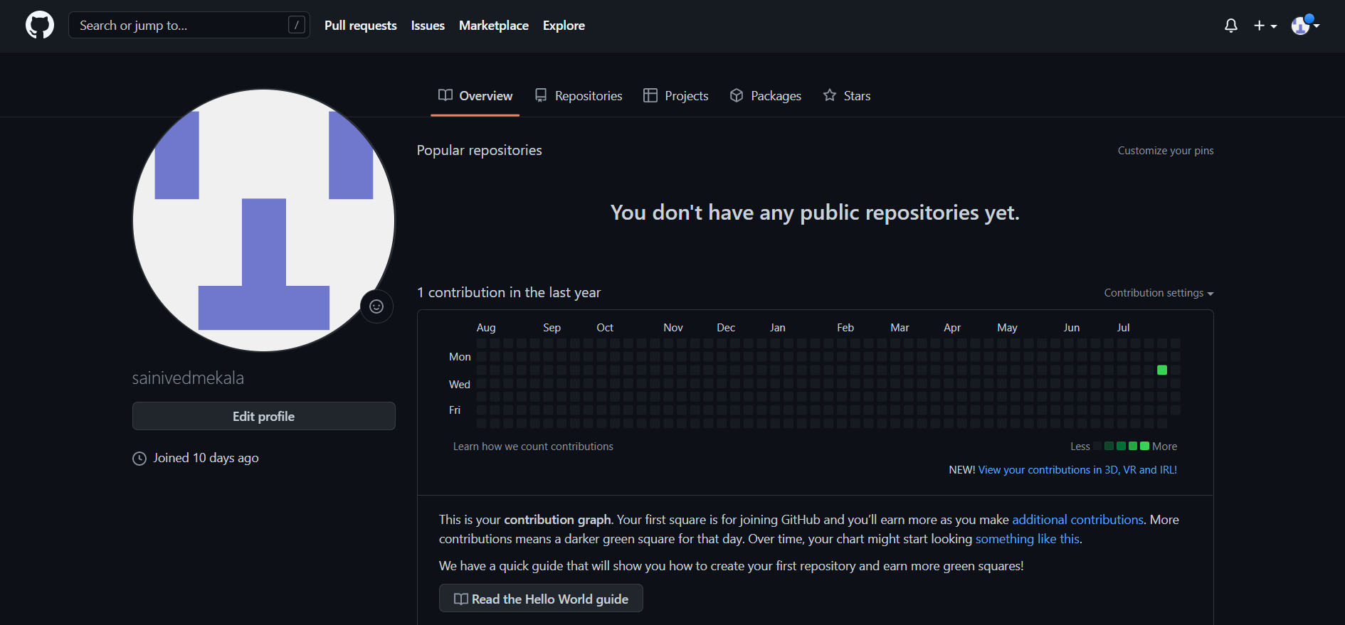
https://github.com/2110030449
https://github.com/sainivedmekala

Slide 13
Individual roles
Ppt – 2110030351
Diagrams – 2110030352
Gathering information – 2110030449 , 2110039476
Coding – 2110030351 , 2110030352 , 2110030449 , 2110039476

Slide 14


